Slide 1

Energy Storage System Modeling Using Time Series Clustering for Long-term Planning
Bangladesh University of Engineering & Technology
Department of Electrical and Electronic Engineering
Course Title: Machine Learning and Pattern Recognition Course No. : EEE 6608
Presented By
Md. Abu Bakkar
ID: 0422062156
Date: 06/01/2025
Supervised By Prof. Dr. Shaikh Fattah

Slide 2
Outline
Background
Objective
Methodology
Result and Discussion
Conclusion
Monday, January 06, 2025

Slide 3
Background
The study of future energy scenarios with high shares of variable renewable energy sources (VRES) requires an accurate representation of VRES variability and storage capacity.
However, long-term optimal expansion models, typically used to prescribe the evolution of energy systems, use coarse time series to limit.
This weakness can entail incorrectly sizing VRES plants and storage facilities.
Monday, January 06, 2025

Slide 4
Objective
Develop a Time-Series Clustering Method: Implement k-means clustering on electricity consumption data to identify representative days and simplify energy system modeling.
State of Charge (SOC) Calculation for ESS: Model and calculate the State of Charge (SOC) of energy storage systems, optimizing charging and discharging rates to balance energy supply and demand.
Optimize Energy Storage System Configuration: Evaluate and optimize different ESS configurations to minimize unmet demand and enhance the integration of renewable energy sources.
Monday, January 06, 2025

Slide 5
Methodology
Clustering Representative Days: A k-means clustering approach is employed to group days with similar energy demand profiles into representative days. The Silhouette Score is then used to determine the optimal number of clusters. A higher Silhouette Score ensures that the clustering effectively represents the underlying energy demand variations.
Chronological Order of Representative Days: the chronological order of representative days is maintained over the entire year. This ensures that the temporal relationships between days, seasons, and demand-supply fluctuations are accurately represented. For instance, after clustering, the model assigns each timeslice of the year to a specific representative day, which helps track energy generation and consumption patterns across periods.
State-of-Charge (SOC) Calculation and ESS Optimization: The State-of-Charge (SOC) of the Energy Storage System (ESS) is dynamically updated at each time step, taking into account energy flow, charge/discharge efficiencies, and system configuration. This enables accurate modeling of the ESS's behavior and supply-demand balancing. The optimization process then ensures the configuration of the ESS (including capacities and charge/discharge rates) minimizes unmet demand and optimizes energy storage utilization over the simulation period.
Monday, January 06, 2025

Slide 6
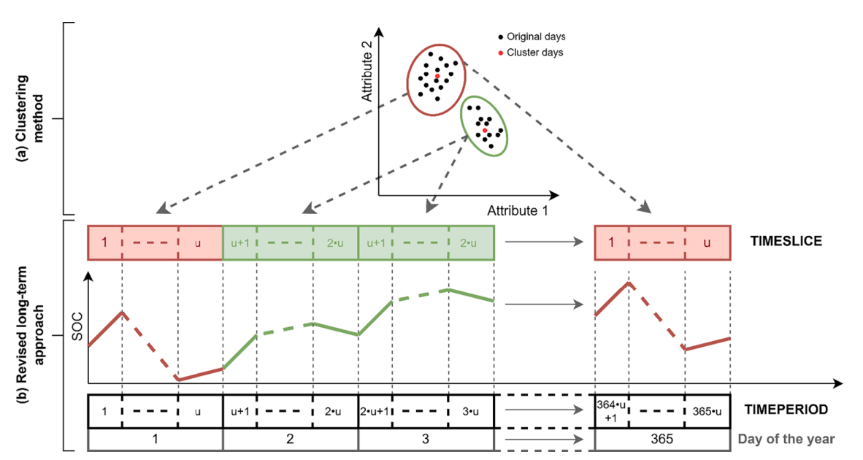
Fig. 1. The implemented methodology consists of two parts: (a) a clustering method, which is applied to the original time series in order to generate inputs for the long-term energy model (the image represents a basic case with two attributes and two clusters; each representative day consists of u timeslices); (b) a revised long-term approach, based on OSeMOSYS, in which timeslices are decoupled from seasons and day types; to do so, the new timeperiod set is introduced, while the season,
daytype and dailytimebracket sets are no longer needed [1].
Monday, January 06, 2025

Slide 7
The dataset, used here, provides hourly time-series data on electricity consumption and production over a span of more than five years. It includes detailed information on total electricity consumption and production, with production categorized by source: nuclear, wind, hydroelectric, oil and gas, coal, solar, and biomass. All values are recorded in megawatts (MW), with timestamps marking each hour. This extensive dataset is ideal for analyzing trends like seasonal variations, renewable energy contributions, and fossil fuel dependency. It also supports innovation in energy technologies, such as optimizing storage systems, and enables detailed statistical analyses and forecasting for improved energy production and consumption planning.
Results and Discussion:
Monday, January 06, 2025

Slide 8
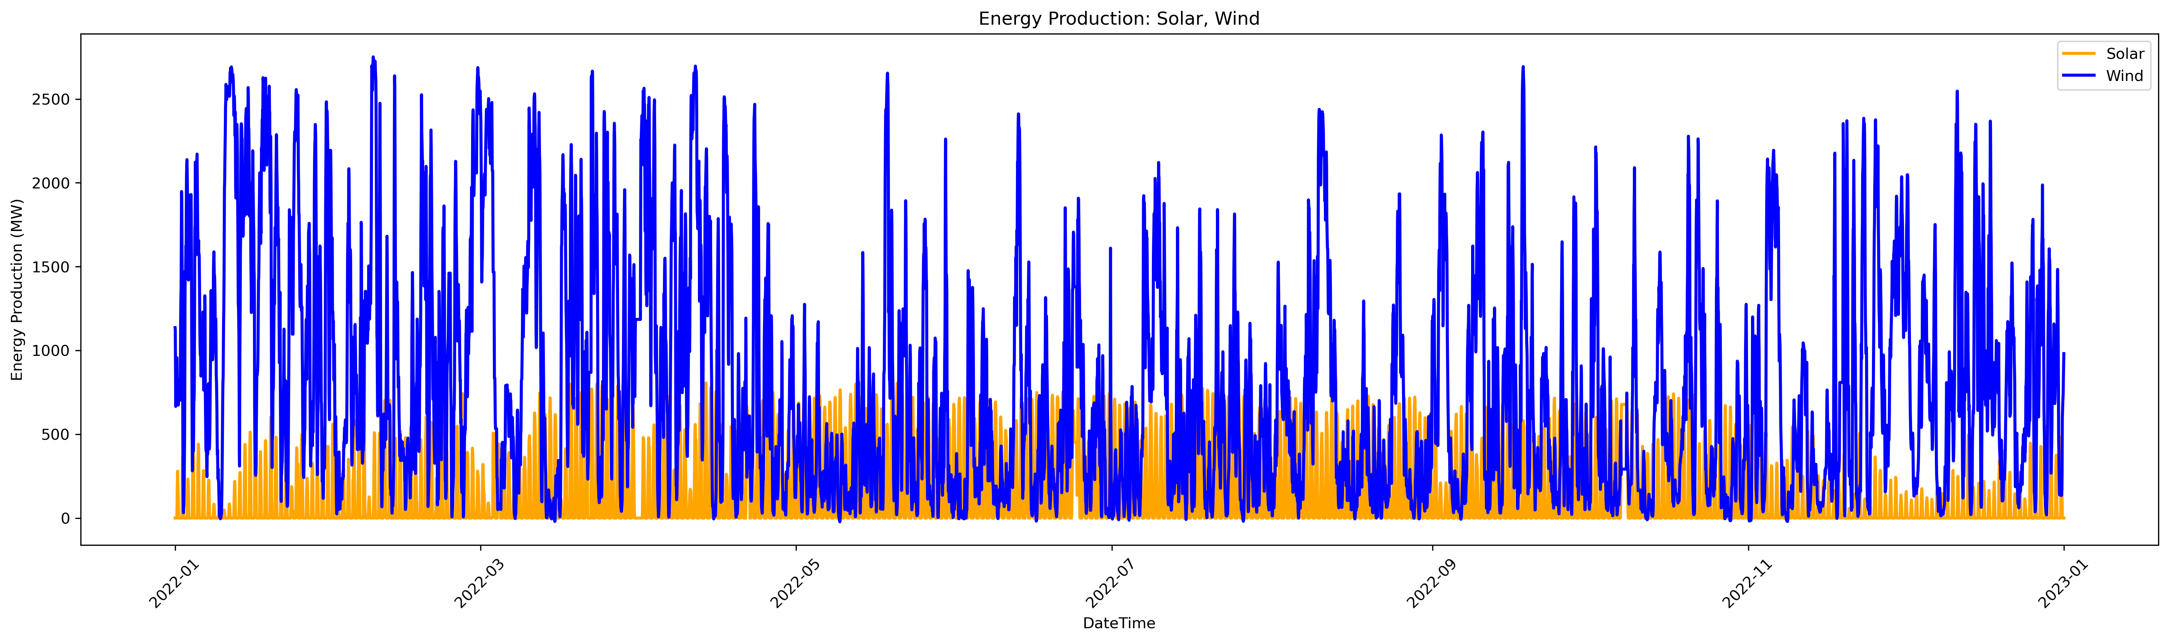
In Fig. 2. we can see the intermittence of solar and wind
Results and Discussion:
Fig. 2. Energy production of solar and wind
Fig.2. Clusters and Silhouette Score
Monday, January 06, 2025

Slide 9
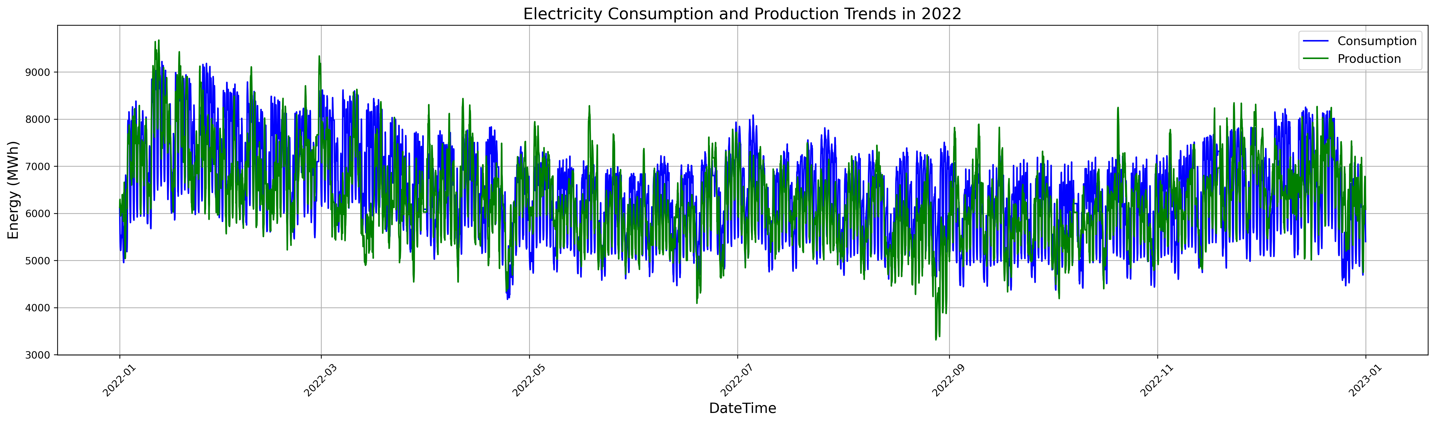
Results and Discussion:
In Fig. 2. we can see the variability of Energy production and consumption
Fig. 3. Energy production and consumption
Fig.2. Clusters and Silhouette Score
Monday, January 06, 2025

Slide 10
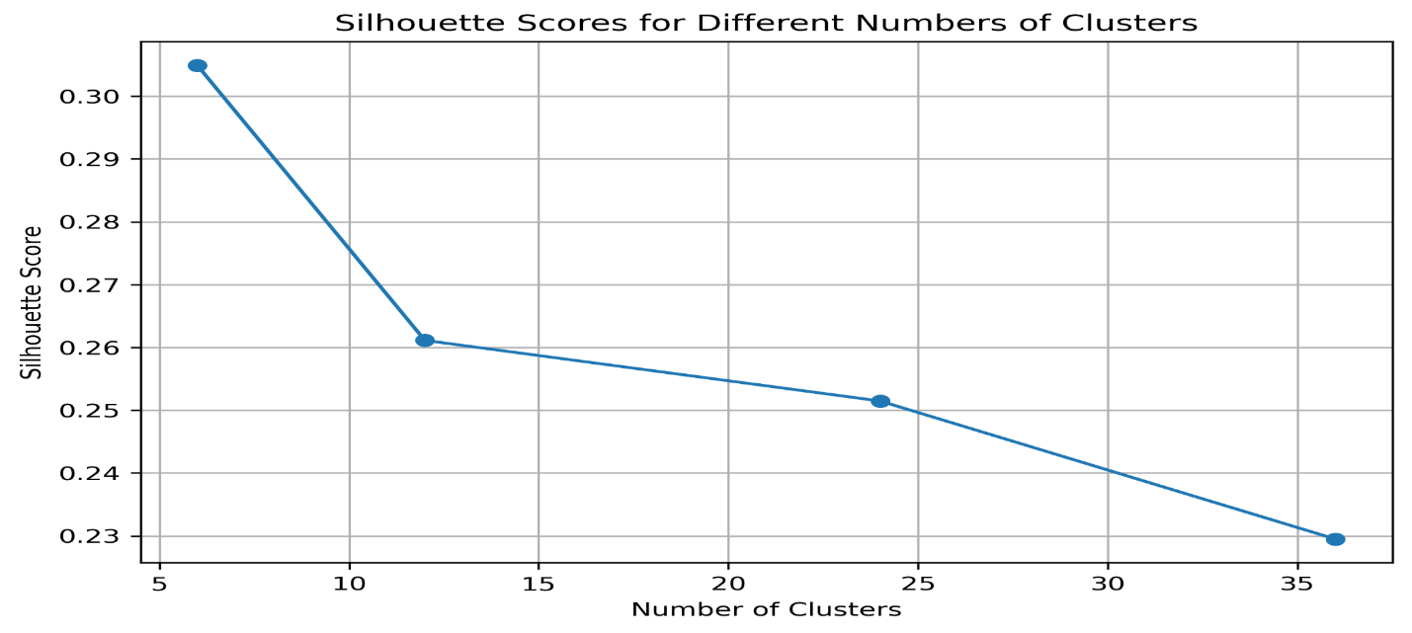
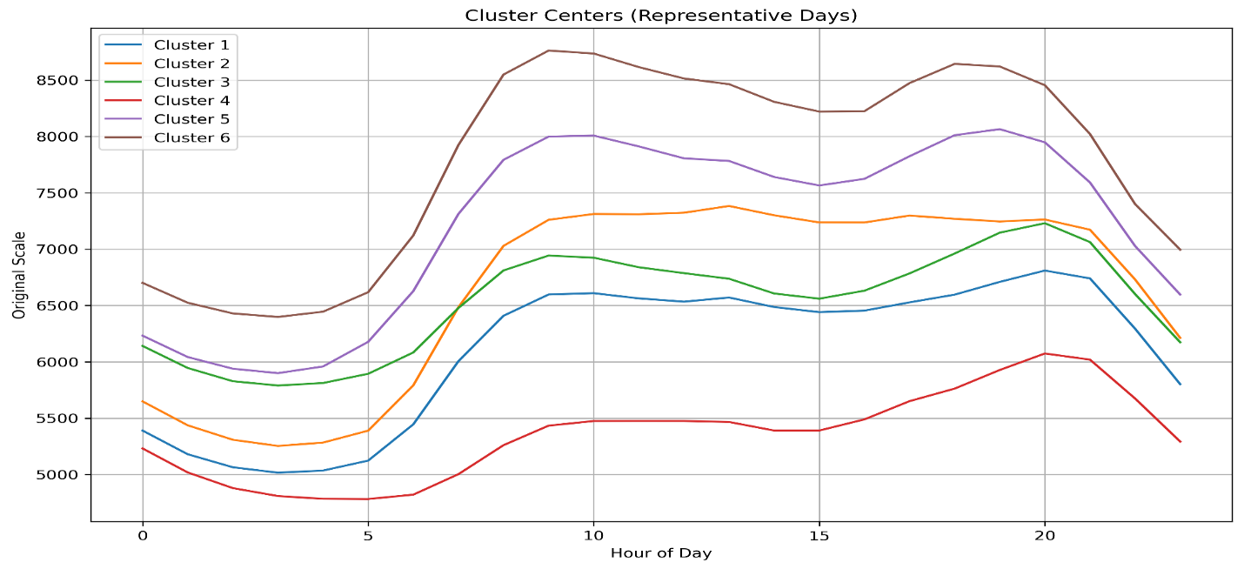
The clustering of representative days using the k-means method was carried out successfully with different cluster sizes (6, 12, 24, and 36) and 6 no cluster gave good performance for higher value of silhouette score.
Results and Discussion:
Fig.4. Clusters and Silhouette Score
Monday, January 06, 2025

Slide 11
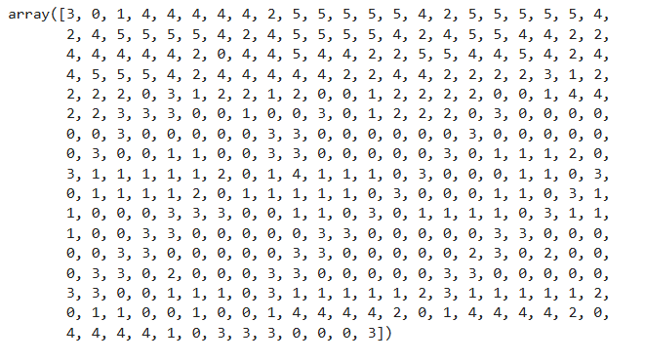
Clustered representative days with new chronological order over 365 days of the year by cluster values.
Monday, January 06, 2025

Slide 12
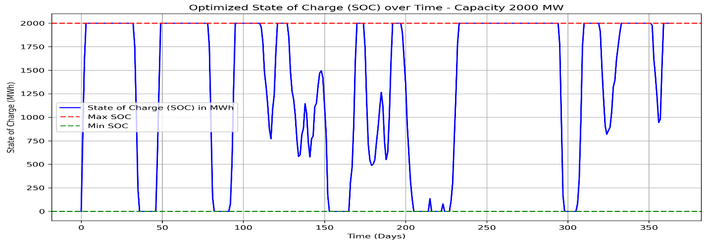
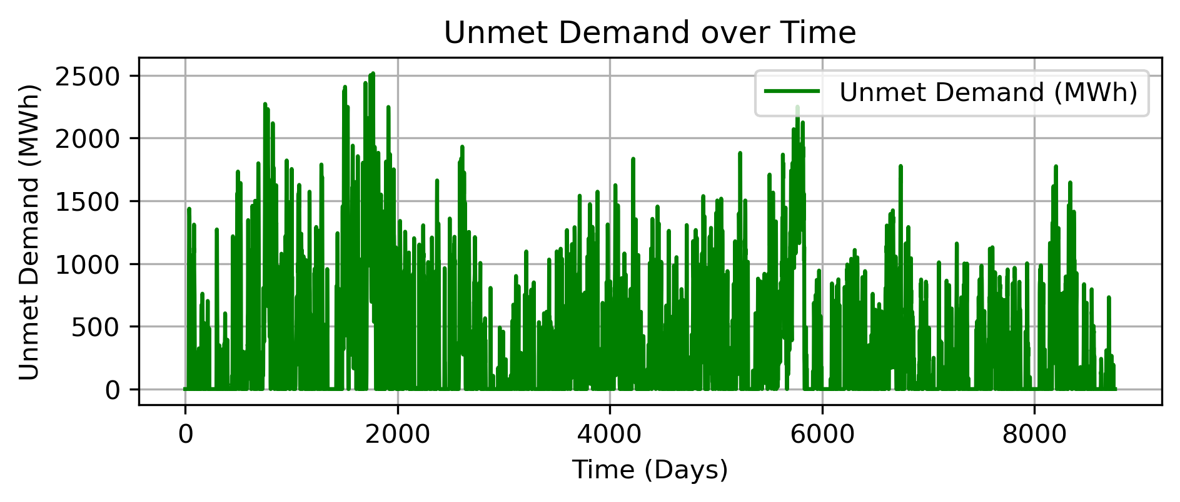
The simulation demonstrated that an ESS with a 2000 MW capacity and 800.0 MWh/day charge/discharge rates reduced unmet demand to 3,203.008 GWh, balancing annual supply (55,204.163 GWh) and demand (56,292.449 GWh).
Monday, January 06, 2025

Slide 13
Conclusion
The study introduced a k-means clustering approach for grouping representative days.
The dynamic calculation of the state-of-charge (SOC) demonstrated the effective use of energy storage systems (ESS) in balancing supply and demand.
The simulation showed that an ESS with a 2000 MW capacity and 800.0 MWh/day charge/discharge rates reduced unmet demand to 3,203.008 GWh, efficiently balancing annual supply (55,204.163 GWh) and demand (56,292.449 GWh).
Reference paper
[1] R. Novo, P. Marocco, G. Giorgi, A. Lanzini, M. Santarelli, and G. Mattiazzo, “Planning the decarbonisation of energy systems: The importance of applying time series clustering to long-term models,” Energy Conversion and Management: X, vol. 15, p. 100274, Aug. 2022, doi: 10.1016/j.ecmx.2022.100274.
Monday, January 06, 2025

Slide 14

Thank You
Monday, January 06, 2025

